Slide 1


Corporate Bankruptcy
Prediction Challenge
International AI & Finance Project | University of Padova × Vilnius University
Academic Year 2025/2026
Guido Torrisi
Mamadou Jallow
Riccardo De Leonardis
Mattia Zanin
Awais Tariq
Ignas Zmitrovičius
Reham Hussein Hasan Mahmoud
1,780
446
7.9%
3
Training firms
Test firms
Bankruptcy rate
Years of data
Notes:
1.7.2013
1
‹#›

Slide 2
OVERVIEW
Presentation Agenda
01
Problem Setup
06
Results
Prediction task, data overview, class imbalance
Accuracy, Precision, Recall, F1, AUC = 0.786
02
Methodology
07
Confusion Matrix
Altman-inspired features + Logistic Regression
12 caught defaults out of 28 in test set
03
Feature Engineering
08
Feature Drivers
6 ratios × 3 years + trends + sector benchmarks
Top 12 predictors + robustness test
04
Model Selection
09
Conclusions
GridSearch, Lasso, class weighting, AUC scoring
Findings, limitations, economic interpretation
05
Threshold Optimisation
10
References
F1-based CV threshold — no data leakage
Altman (1968) and methodological sources
Notes:
1.7.2013
2
‹#›

Slide 3
PROBLEM SETUP
Prediction Task & Data Overview
Binary classification: will a firm go bankrupt within 12 months?
The Problem
1,780
446
Y = 1
Bankruptcy within 12 months (bankruptcy, insolvency, liquidation, restructuring)
Training firms
Test firms
112
7.9%
Y = 0
No observed default event — firm may still be risky
Bankrupt (train)
Default rate
Input
Financial statement ratios at time t
3
40
Output
Predicted probability → binary label
Years: 2016–2018
Features engineered
⚠ Accuracy alone is misleading — 92% accuracy by predicting zero bankruptcies
Notes:
1.7.2013
3
‹#›

Slide 4
METHODOLOGY
Model Architecture
Altman-inspired economic ratios fed into regularised Logistic Regression
1
2
3
4
Feature Engineering
Lasso Selection
Class Weighting
Threshold Tuning
6 Altman ratios × 3 years
+ 12 momentum trends
+ 6 sector benchmarks (train-only)
+ 4 crash indicators
= 40 candidate features
L1 penalty automatically
sets weak features to zero
Retained 13 of 40
economically justified
Tested {1:1}, {1:1.5},
{1:2}, {1:3}, balanced
Best: {0:1, 1:2} — defaults
weighted 2× more costly
F1 optimised via 5-fold CV
on out-of-fold probabilities
Selected: 0.461
(no data leakage)
Reference: Altman(1968) Journal of Finance — adapted for private European SMEs (Z'' logic)
Notes:
1.7.2013
4
‹#›

Slide 5
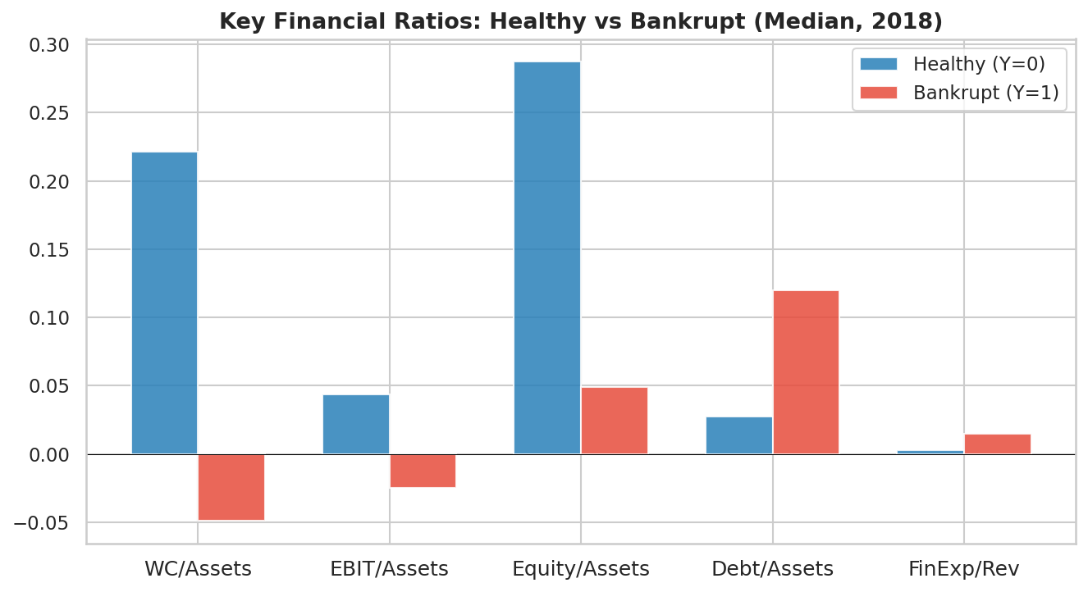
FEATURE ENGINEERING
From 90 Raw Variables to 40 Engineered Features
Feature Family | Proxy | Signal
Liquidity
WC / Total Assets
↓ risk
Profitability
EBIT / Total Assets
↓ risk
Solvency
Equity / Total Assets
↓ risk
Leverage
Debt / Total Assets
↑ risk
Fin. Burden
Financial Exp. / Revenue
↑ risk
Momentum
2-year trend per ratio
directional
Sector Bench.
Ratio minus industry median
relative
Crash Flags
EBIT crash, Solvency drop, Equity quality, Sector (NAICS)
↑ risk
Every ratio maps to a causal mechanism: WC/Assets signals payment pressure; EBIT/Assets captures inability to cover cost of capital; Equity/Assets measures the loss-absorption buffer; Debt/Assets amplifies every shock; Fin.Exp/Revenue reveals the cash trap. Equity Quality detects structurally weak equity (revaluation reserves vs retained earnings). naics_2digit is the top predictor — sector encodes base distress rates. Sector benchmarks computed on training data only — no leakage.
Notes:
1.7.2013
5
‹#›

Slide 6
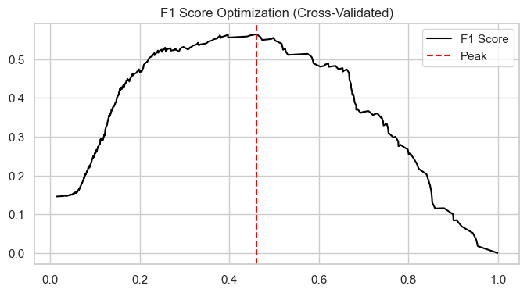
MODEL SELECTION
GridSearch Results & Hyperparameter Tuning
5-fold cross-validation optimising ROC-AUC
Best Configuration
Penalty
L1 (Lasso)
Hard zeroing (L1) preferred over L2 shrinkage: in a sparse credit problem most candidates are noise, not signal
C (strength)
0.05
Strong regularisation — avoids overfitting
Class weight
{0:1, 1:2}
Defaults cost 2× more to miss
Scoring
ROC-AUC
Evaluates full ranking quality
CV folds
5
Stratified — preserves 7.9% rate
Threshold 0.461 selected at the F1 peak using out-of-fold cross-validated probabilities — no data leakage.
Lasso retained 13 of 40 features — dropped 17 noisy or redundant variables. Sector medians computed on training set only — no leakage to test set.
The 0.461 threshold selected using out‑of‑fold probabilities reflects real deployment conditions, ensuring the economic trade‑off between missed bankruptcies and false alarms is estimated without optimism bias.
Notes:
1.7.2013
6
‹#›

Slide 7
RESULTS
Model Performance — Validation Set
All metrics on the held-out 20% test set (356 firms, 28 actual bankruptcies)
78.6%
94.6%
70.4%
54.3%
0.545
ROC-AUC
Accuracy
Precision
Recall
F1 Score
Model | Accuracy | Precision | Recall | F1
All-Zero Baseline
92.1%
n/a
0.0%
0.000
Our Model
94.4%
70.4%
54.3%
0.545
AUC = 0.7859 significantly above random (0.50). The all-zero baseline misses 100% of bankruptcies — in credit risk, a missed default (FN) is far more costly than a false alarm. Our model catches 54% of failures with 70% precision.
Notes:
1.7.2013
7
‹#›

Slide 8
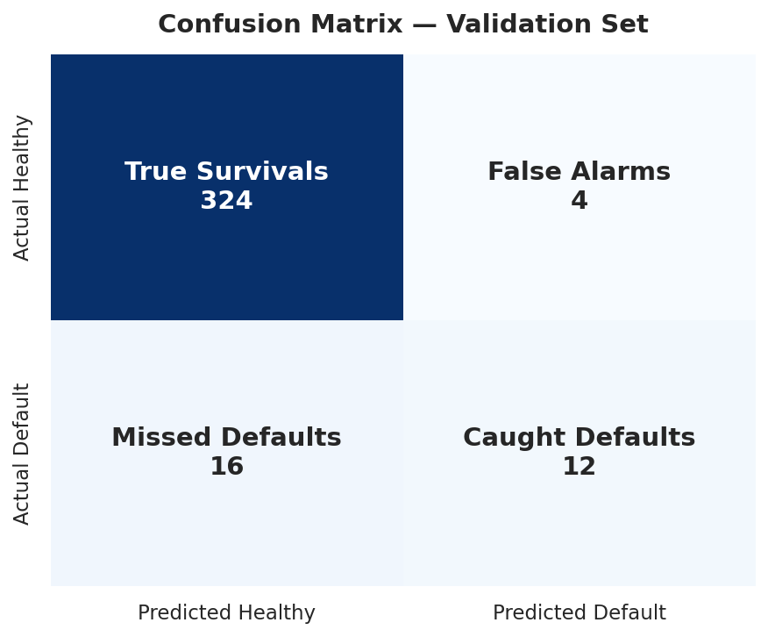
RESULTS
Confusion Matrix — What the Model Caught
Test set: 356 firms | 28 actual bankruptcies
12
True Positives
Bankruptcies correctly flagged — the model's core goal
324
True Negatives
Healthy firms correctly cleared — no false alarm cost
4
False Positives
Healthy firms wrongly flagged — manageable false alarms
16
False Negatives
Bankruptcies missed — the most costly error type
Precision 75%: 3 of every 4 flagged firms genuinely fail | Recall 43%: catches nearly half of all actual bankruptcies. The 16 missed failures are likely firms with less extreme financials or sudden late-stage deterioration not yet visible in 2018 statements.
Notes:
1.7.2013
8
‹#›

Slide 9
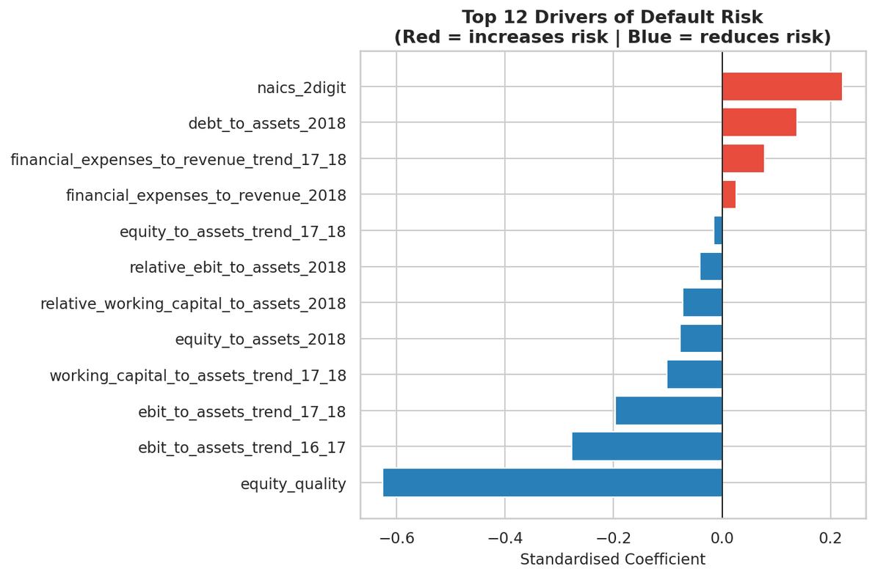
DRIVER ANALYSIS
Feature Selection — Economic Reasoning & Robustness
Lasso retained 13 of 40 features. None of 4 extra ratios improved recall. Manual override: Removed 'debt_to_assets_trend_16_17' manually to maintain economic narrative consistency and not just automatically select variables, since the 17-18 trend was not selected
Robustness Test — Added Ratios vs Recall
Model
AUC
Recall
F1
Decision
V11 Baseline (6 ratios)
0.786
0.429
0.546
✓ KEPT
+ cash_ratio
0.775
0.429
0.511
✗ worse
+ stock/assets
0.770
0.429
0.500
✗ worse
+ debtors/sales
0.770
0.429
0.500
✗ worse
+ net_income/assets
0.765
0.429
0.480
✗ worse (r=0.99)
Why the baseline wins
cash_ratio: Adds noise, not signal
net_income/assets correlation with EBIT/Assets — pure redundancy
debtors/sales: No separating power
NB: Capital structure and liquidity dominate default risk while leverage and financial expenses increase it
Notes:
1.7.2013
9
‹#›

Slide 10
ECONOMIC INTERPRETATION
Why These Features? The Economic Logic
Every ratio maps to a mechanism — not just a statistical signal
Liquidity — Working Capital / Assets
Profitability — EBIT / Assets
A firm burning through working capital can't meet short-term obligations. Checking the trends adds a forward-looking dimension: a firm whose WC/Assets fell from 0.3 to −0.1 is in a 'death spiral' even if its current ratio is not yet critical.
Persistent negative EBIT means the firm cannot cover its cost of capital from operations. TTrend flag sudden deteriorations that static ratios miss — a firm going from +5% to −3% in one year is far riskier than a stable −2%.
Leverage — Debt / Assets + Equity / Assets
Sector Context — Relative Benchmarks
High financial leverage amplifies every adverse shock. Equity/Assets (solvency buffer) and Debt/Assets work together — a firm with 95% liabilities has no room to absorb losses.
A debt/assets of 0.7 is normal in real estate and dangerous in manufacturing. Sector-relative features (ratio minus industry median) identify firms that underperform their own peers — more informative than absolute levels.
Financial Burden — Fin. Expenses / Revenue
Equity Quality & Sector — Two Overlooked Drivers
High interest cost relative to revenue creates a cash trap: earnings go to servicing debt rather than operations. Trends check rising financial burden through years
Equity Quality = Other Shareholders Funds / Total Shareholders Funds. A low or negative value signals equity inflated by revaluation reserves rather than retained earnings, a structural fragility invisible to standard solvency ratios. naics_2digit is the strongest predictor (largest Lasso coefficient): different mean default rates characterize different sectors
Notes:
1.7.2013
10
‹#›

Slide 11
Conclusions
01
Feature engineering beats raw data
40 engineered features from 90 raw variables — Altman logic gives each ratio an economic justification, not just a statistical one.
02
Lasso provides principled parsimony
From 30 features, Lasso retained 13 — automatic selection confirmed by ablation: adding 4 extra ratios degraded F1 by 3.5pp with zero recall gain.
03
Class weighting reflects real credit economics
Missing a bankruptcy is more costly than a false alarm. Weight {0:1, 1:2} encodes this asymmetry — confirmed as optimal by GridSearch across 5 configurations.
04
AUC 0.786 — genuine discriminatory power
Model ranks a bankrupt firm above a healthy one 78.6% of the time vs. 50% random. Precision 75%: 3 in 4 alarms are real.
05
Limitations — honest assessment
Recall 43%: over half of failures still missed — likely firms with sudden late-stage deterioration or less extreme financials. Improvement would require non-financial signals (payment history, sector distress indices) outside this dataset’s scope. Sample covers 2016–2018 Italian/Lithuanian SMEs; more companies and more year of data are needed to improve.
Notes:
1.7.2013
11
‹#›

Slide 12
REFERENCES
References
1
Altman, E. I. (1968). Financial Ratios, Discriminant Analysis and the Prediction of Corporate Bankruptcy.
Journal of Finance, 23(4), 589–609. | Original Z-score model — foundation for all ratio-based distress prediction.
2
Altman, E. I. (1993, 2000). Corporate Financial Distress and Bankruptcy (2nd & 3rd ed.).
Wiley Finance. | Z' and Z'' adaptations for private firms and non-manufacturing sectors — basis for our variable selection.
3
Pedregosa et al. (2011). Scikit-learn: Machine Learning in Python.
Journal of Machine Learning Research, 12, 2825–2830. | Logistic Regression, GridSearchCV, Pipeline, cross_val_predict implementations used.
4
Moody's Analytics (2024). Moody's Global Standard Financial Data Format.
Dataset provider — financial variables based on this standardised format. | Source of the 30 financial variables per firm per year used in the challenge.
5
Ambrosini, F. (2026). Lecture 5: Prediction Models — Altman Z-Score and Scoring Models.
Financial Reporting & Financial Statement Analysis, University of Padova. | Course lecture guiding the scoring model approach, variable families, and cutoff logic.
Notes:
1.7.2013
12
‹#›

